Slide 1
What Do Advisors Need To Know?
General Policies and Procedures around finances

Slide 2
SGA Allocation Bylaws
We encourage all advisors to review the SGA Allocation Bylaws in full.
Student organizations should be fundraising in addition to requesting funding from SGA.
Exclusive organizations will not be funded through SGA.
Philosophy Statement from Allocation Bylaws
The intention of the student activity fee is to benefit the most amount of students, as all undergraduate students contribute to this fee. We believe we are impartial stewards of this funding and have the responsibility to fulfill this intention.

Slide 3
Outline
Introductions
Basic Info on Student Orgs
SGA
Annual Requests
Semester Requests
Allocations Committee
Student Services, Inc. (SSI)
SSI Forms
SSI Policies
General Practices

Slide 4
Contact Information
Student Services, Inc. (SSI)
Danielle Leahy – Venmo/Reimbursements
DLeahy946@wcupa.edu (610) 436-2357
Suzanne Blackman – Payroll/Services
SBlackman@wcupa.edu (610) 436-3559
Nicole Landwersiek – Credit Card/Reimbursements
NLandwersiek@wcupa.edu (610) 436- 2836
Donna Snyder – Executive Director/Contracts
DSnyder@wcupa.edu
General Student Services, Inc.
Email: ssi@wcupa.edu
Student Government Association (SGA)
Kimberly Farrer – Director of Student Engagement
Email: KFarrer@wcupa.edu
Kiara Guzman-Ramos – Assistant Director of Student Engagement
Email: kguzman-ramos@wcupa.edu
Sydney Culhane - Director of Allocations
Email: SGATreasurer@wcupa.edu

Slide 5
Basic Information on Student Organizations
Each student organization has access to an SSI account
SSI accounts hold all the organization's funds and acts as a bank account
If an org does not have an SSI account, they are able to apply for one for free
Forms are found in the SSI office or online (https://wcustudentservices.com/ssi-forms/)
Mandatory Treasurer Trainings are provided at the starting of the academic year
Treasurers from each org are trained on both SSI and SGA's policies and procedures
Failure to attend required trainings can result in a hold on your organization's SSI account
Operational Budget Requests are made in the Spring Semester for the following academic year, and Semester Requests can be made on a rolling basis
Unused SGA allocated dollars are pulled back from orgs at the end of the academic year
Unused fundraised dollars and org income will remain in the org's SSI account

Slide 6
Annual Budget Requests
Budget requests are submitted in the spring for the following academic year
I.e. budget for the '26/'27 academic year would be submitted in Spring of 2026
These budget requests include general operational expenses only
These are defined below and in the SGA Allocation Bylaws
Funding for on-campus events, conferences, championships, emergencies, etc. will be submitted on a rolling basis throughout the following academic year via the Semester Request Form
Operational expenses are expenses needed for the minimum operation of the club as described in the organization's bylaws
I.e. Food and beverage for general body meetings, supplies used frequently for member meetings, etc.
Requests are submitted to and heard by the Allocations Committee
Timelines will be communicated to orgs and advisors by the Director of Allocations by the end of the Fall semester.

Slide 7
Semester Requests
Formally known as "Aux/Auxiliary Requests"
Heard on a rolling basis by the Allocations Committee
Categorized by:
General Travel
Championship
Conferences
On-Campus Events
Includes any supplies needed for on-campus student orgs hosted social events.
Sponsorships (Having SGA co-sponsor any on-campus activity)
Snap Funding
Emergency requests – account deficits, unexpected expenses, failure to submit annual budget request etc.

Slide 8
Allocations Committee
The annual budget process and semester request process will be determined by the Allocations Committee each year.
There is no limit to the amount of Semester Requests an org may submit
There is no maximum or minimum amount that an org may request
All University policies and procedures for events, travel, food, etc. must be followed
Organizations are no longer required to present for every request submitted
The allocations committee can request a presentation if they see fit
It is up to the discretion of the Director of Allocations to decide if a requests meets the definition of a Semester Request
There is a special process communicated by the Director of Allocations at the end of each fall and spring semester for any semester funds needed during the first 3 weeks of each semester.

Slide 9
Student Service, Inc. (SSI)
SSI Office is located in Room 259 on the second floor of Sykes
Payment vouchers, credit card forms, etc. must be submitted to this office either physically or via email
SSI office provides paper copies of all required forms
Provides budget balance reports as well as list of account transactions as requested
Ticket window is located on the bottom floor of Sykes across from the Theater
Where orgs can deposit checks or cash with the SSI Deposit Slip, obtain cash box, as well as ticket needs for events

Slide 10
SSI Forms
SSI Payment Voucher
SSI Deposit Slip
SSI Credit Card Requests
SSI Purchase Orders

Slide 11
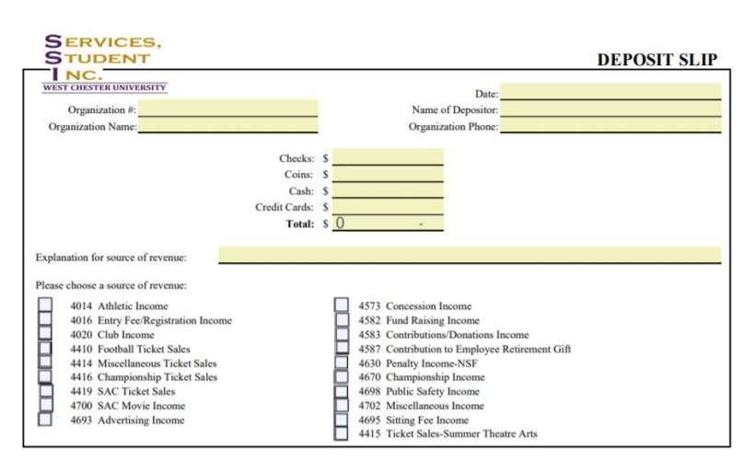
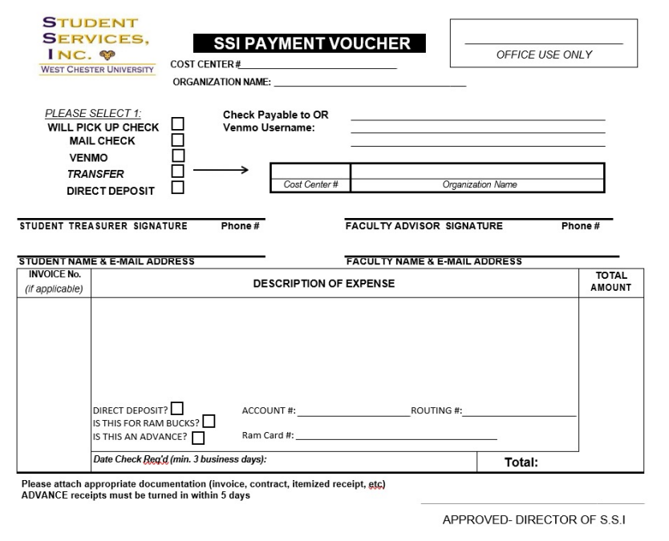
SSI Forms Pt.1
Payment Voucher
Deposit Slip
Used for reimbursements, requests to print out or mail checks, and most small purchases
Also used to fill Org Ram Cards
Used for all deposits (Cash, coins, checks)
Easy to fill out, does NOT need a signature/approval

Slide 12
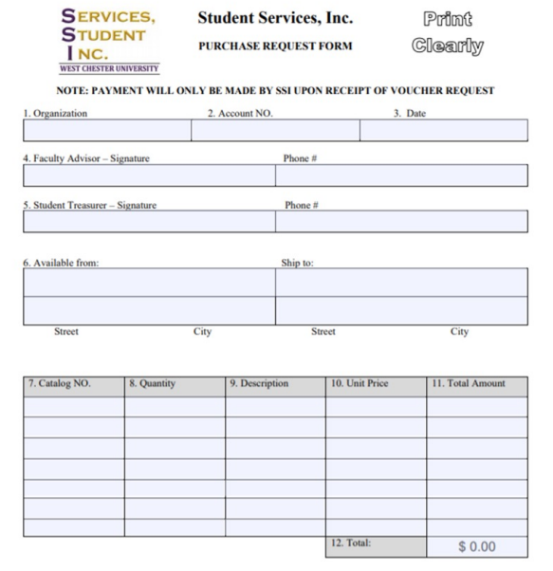
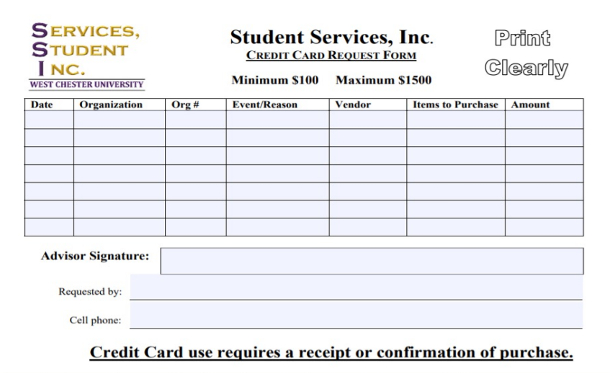
SSI Forms Pt.2
Credit Card Requests
Purchase Request
Generally used for conferences, hotels, and travel.
Students need to get a receipt after any purchases using a credit card form in the SSI office.
Used for larger orders, generally merch, supplies, bus payments, etc.

Slide 13
SSI Credit Card Usage
All organizations looking to use the SSI credit card must fill out the SSI credit card request form and have the advisor approve and sign it
Orgs that are making a purchase greater than $500 are required to fill out the SGA credit card form
Form is found on the SGA website under funding information
When making these larger purchases for vendors, busses, etc., we encourage orgs to utilize the preferred vendor list
List is found on the SGA website under funding information

Slide 14
SSI Policies
The different forms for purchases and payments are meant to streamline money going in and out of SSI for tax reporting purposes
All purchase forms require a signed approval by you as the advisor
Only purchases and actions that result in money leaving the SSI/Student Org account required your signed approval
Ensures that you as the advisor are kept in the know of the organization's financials that are managed by your executive board
Most purchases and deposits take 1-2 business weeks to appear in the SSI accounts

Slide 15
General Practices
We recommend organizations organize their own ledger/spreadsheet to keep track of purchases, income, fundraising, and total balance.
Orgs can find a template for keeping track of funds on the SGA WCUPA website under funding information
We encourage orgs to request an account balance from SSI often to keep in the know of your account balance
Information regarding SGA funding
Forms, supporting documents, additional resources, etc. can be found on SGA WCUPA website under funding information

Slide 16
Thank you

