Slide 1


Slide 2
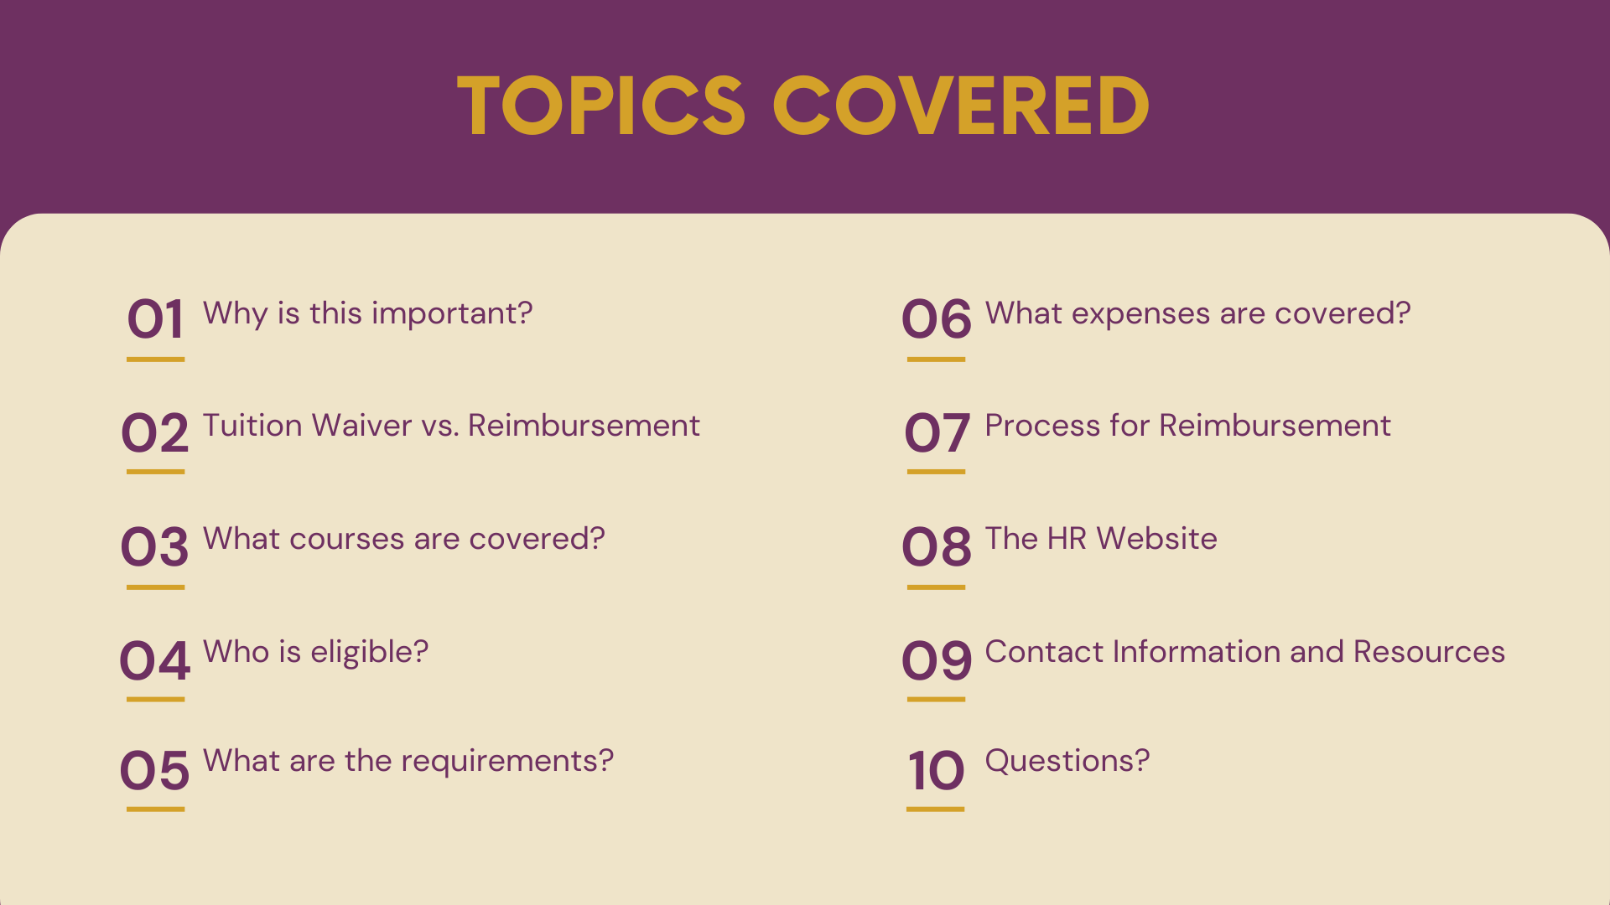

Slide 3
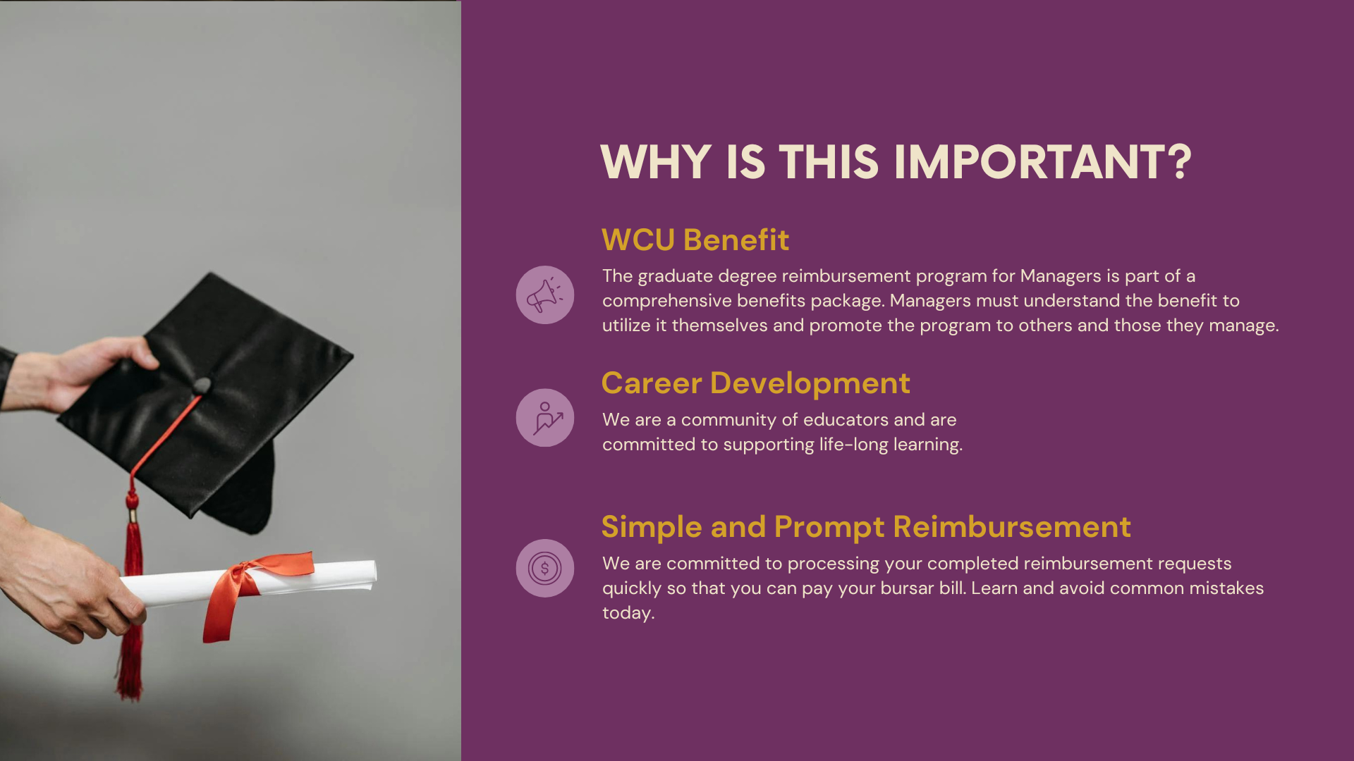

Slide 4
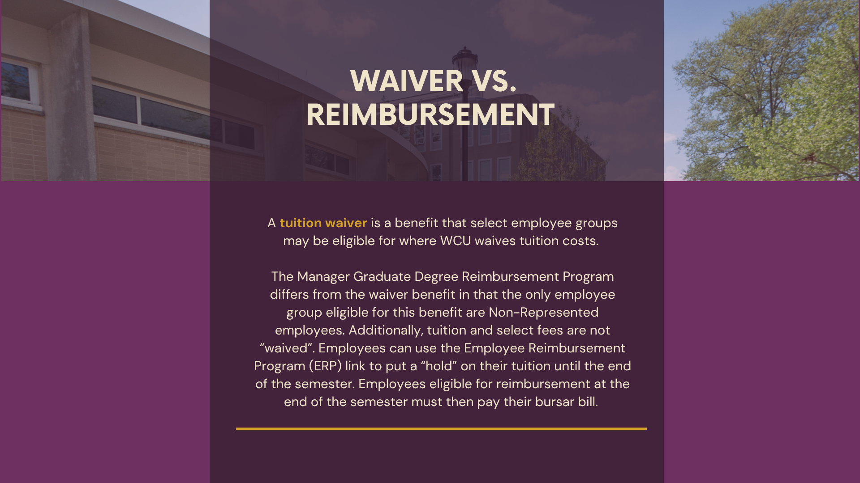

Slide 5
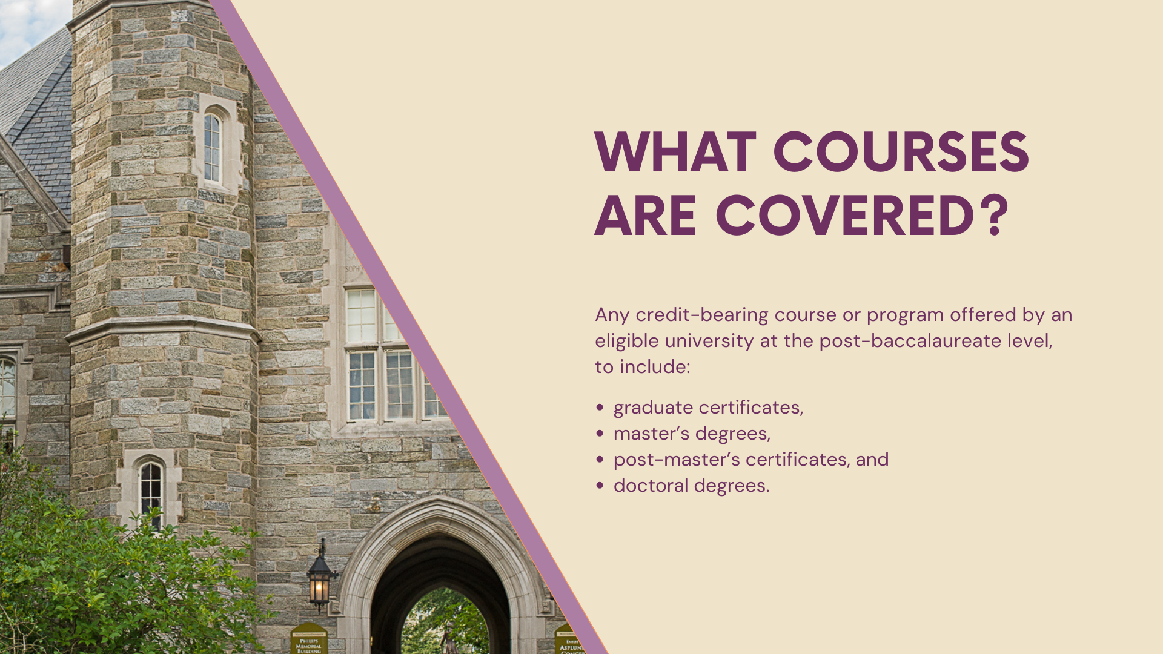

Slide 6
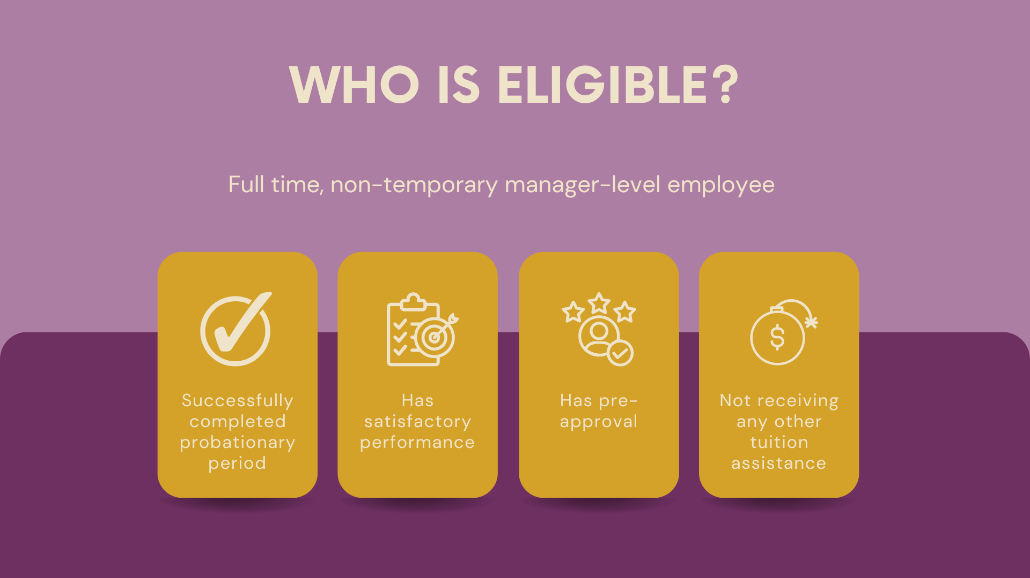

Slide 7
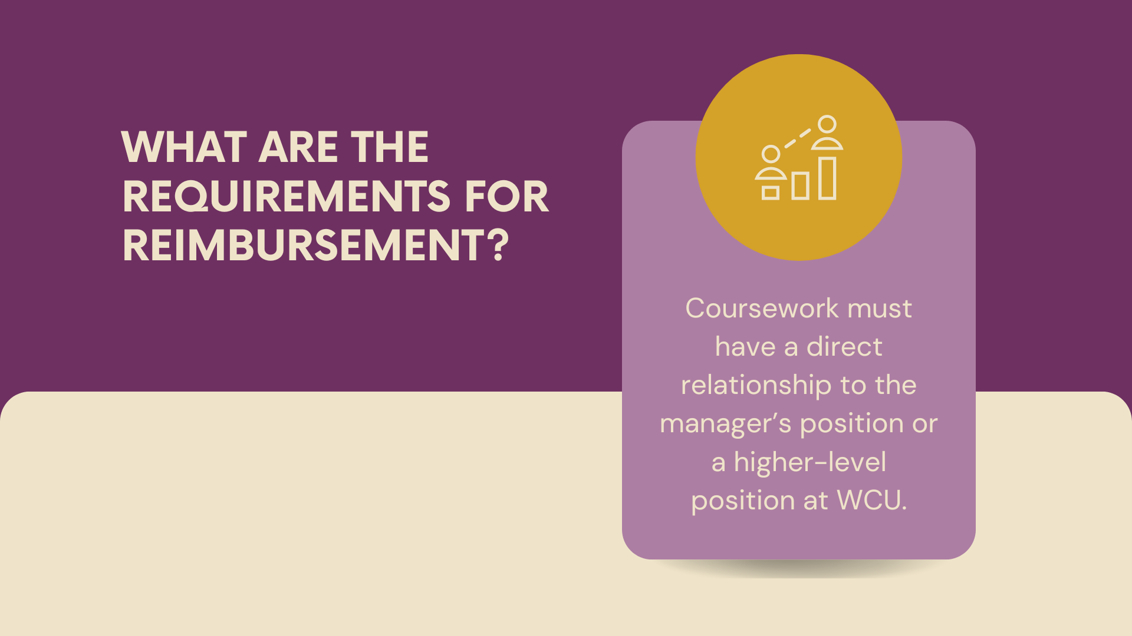

Slide 8


Slide 9
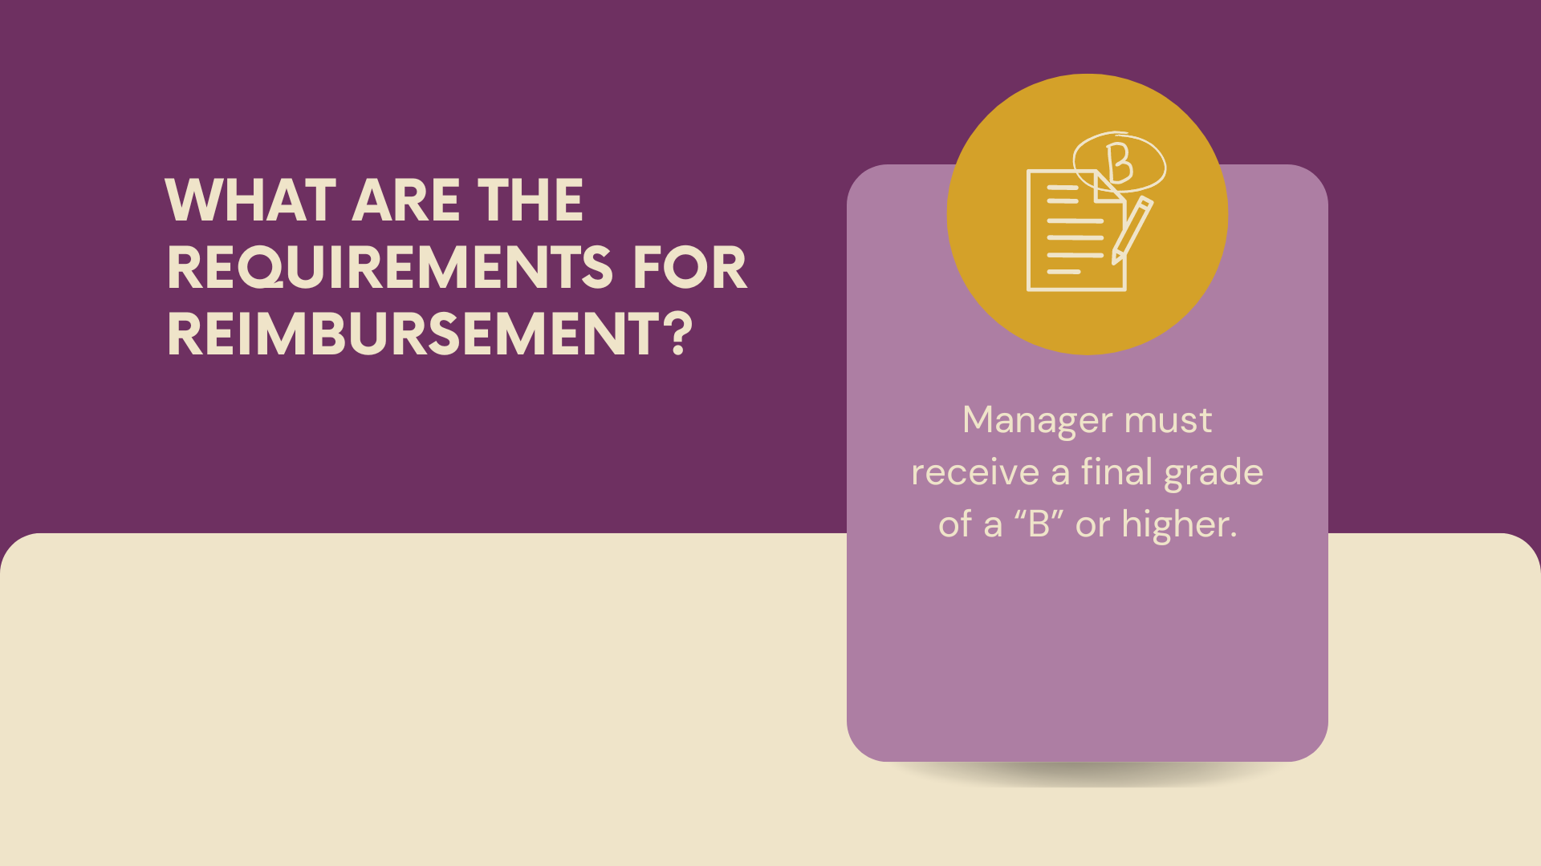

Slide 10
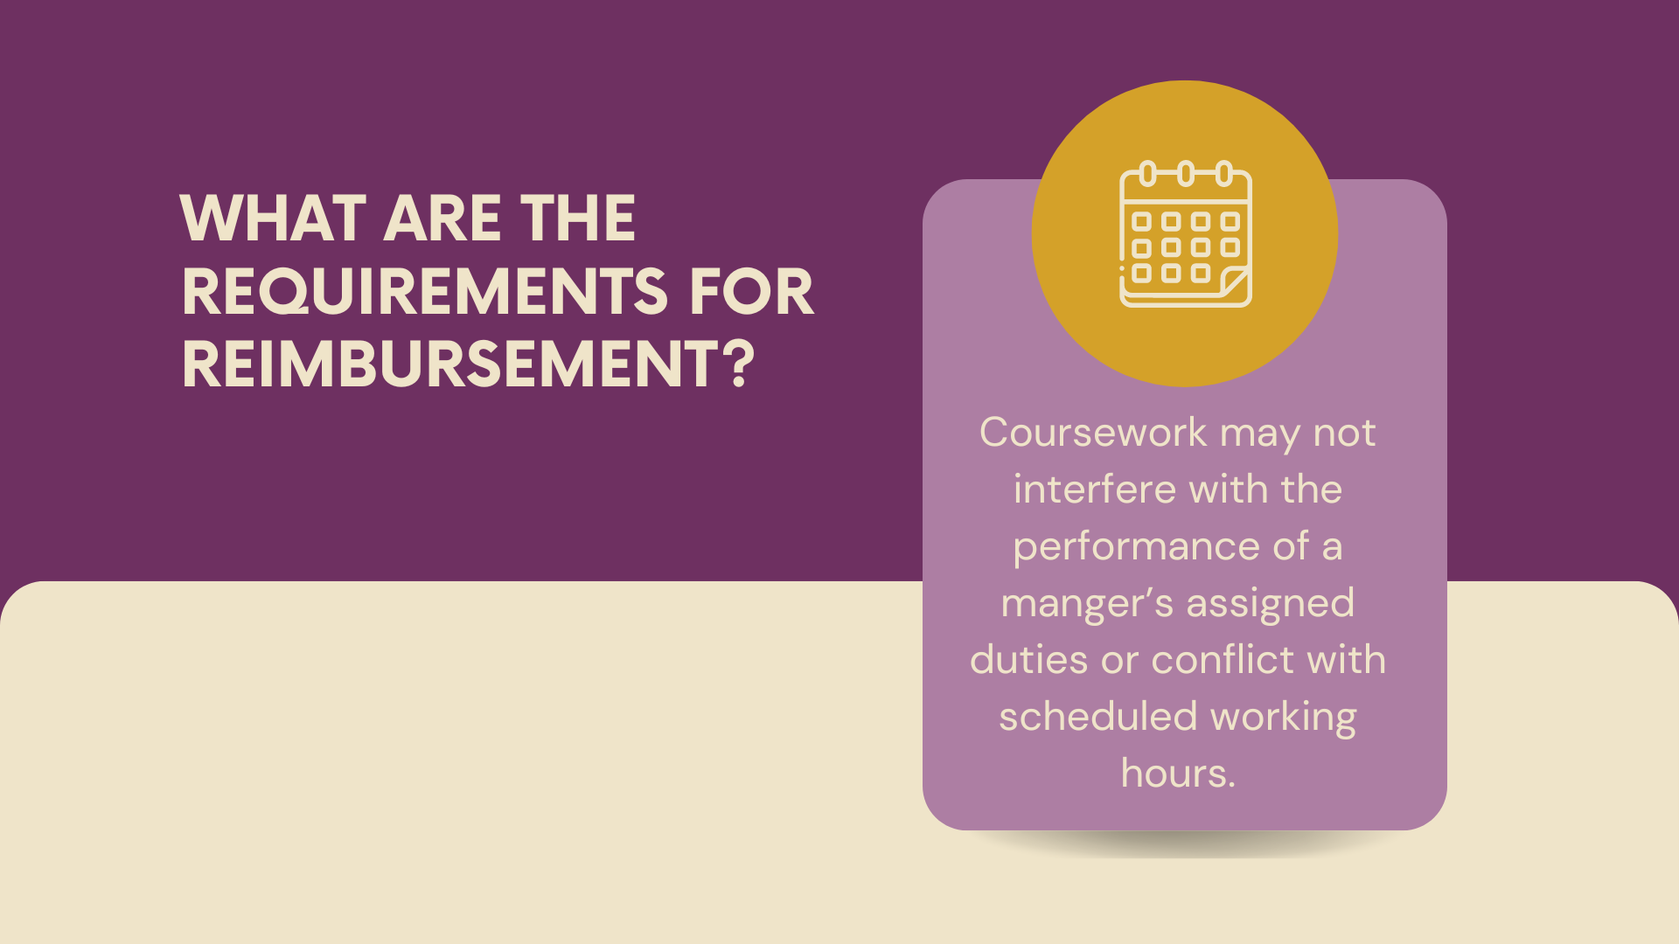

Slide 11


Slide 12
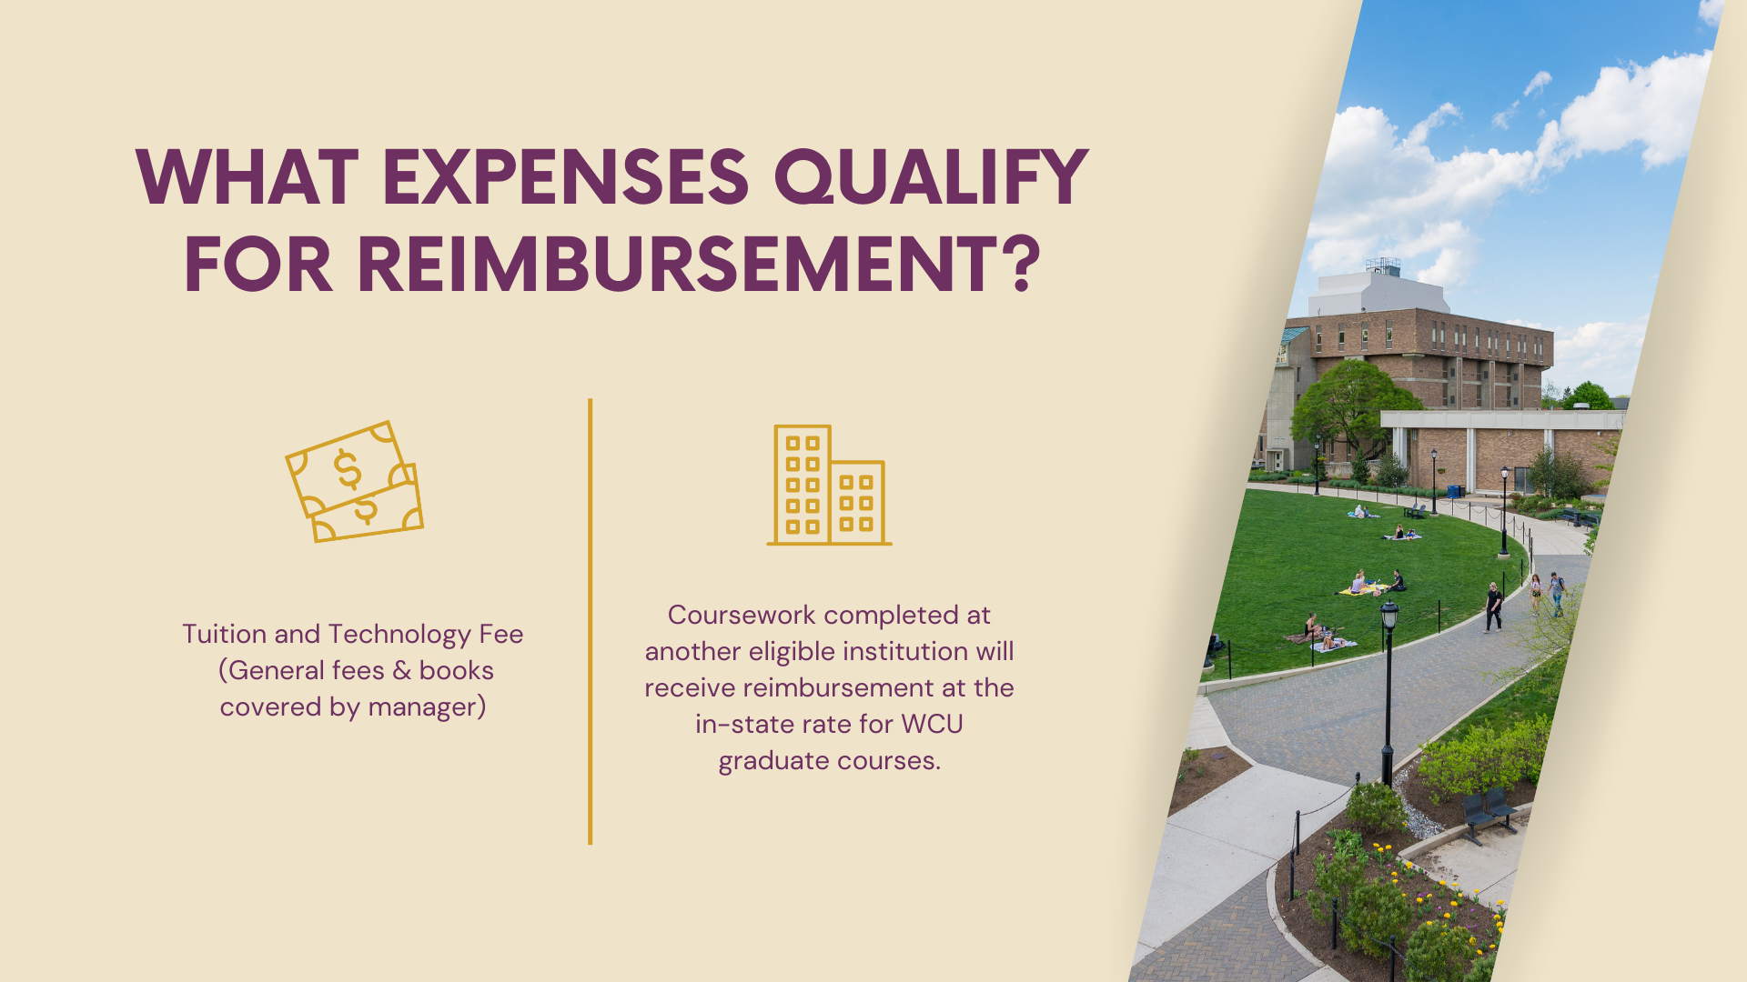
*Approval is also needed from the Academic VP.

Slide 13

PROCESS FOR MGDR PROGRAM
Submit a signed Pre-Approval Form for the program or course to WCU benefits.
(NOTE: You must first be accepted into a graduate program of your choice).​

Slide 14
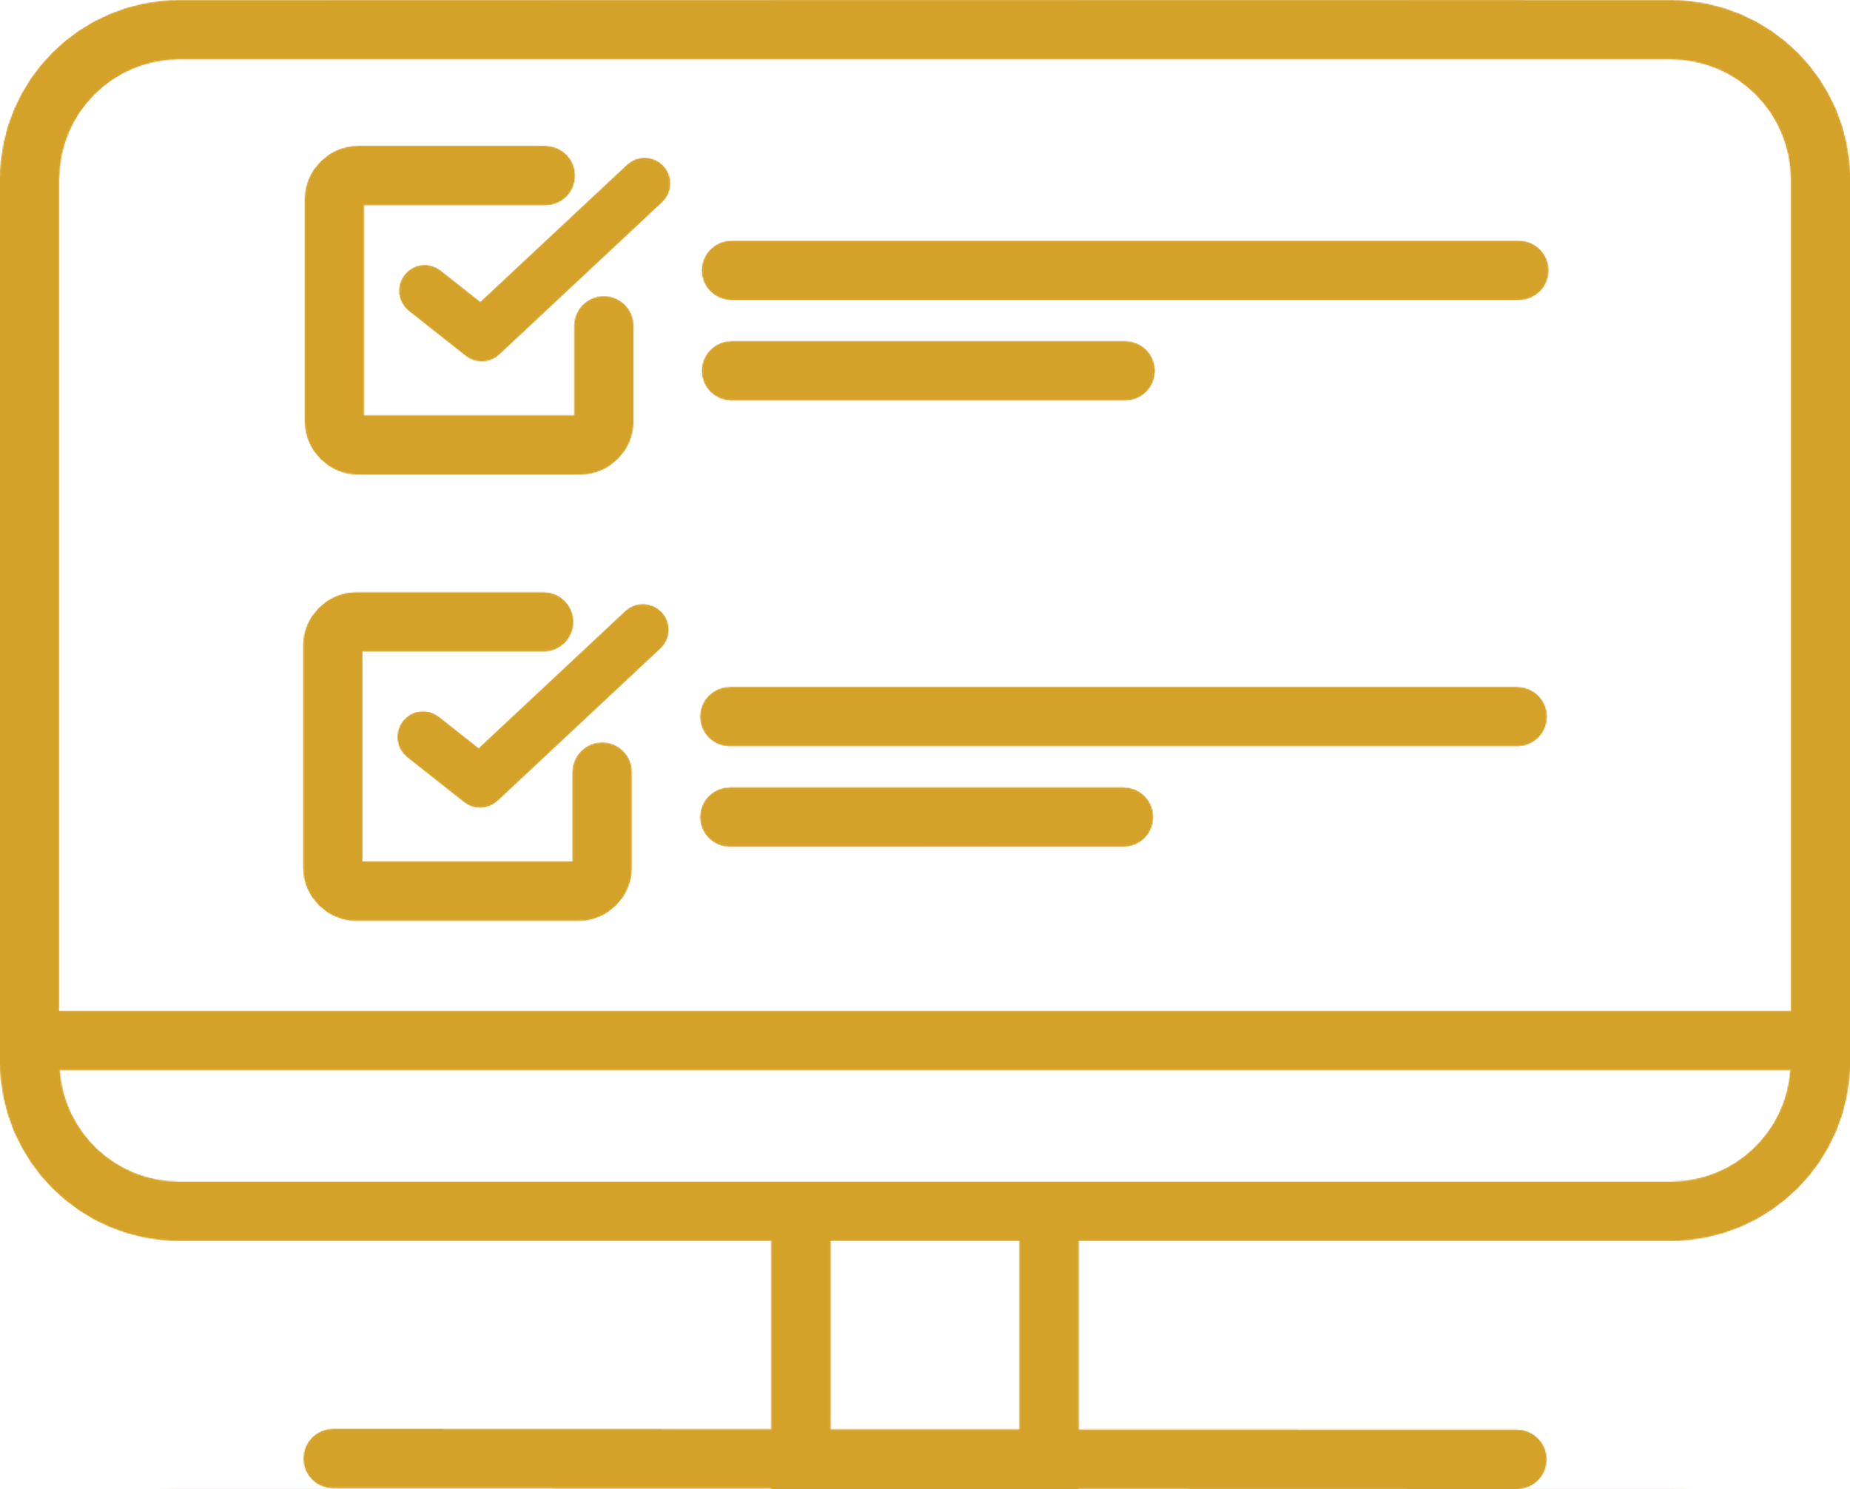
PROCESS FOR MGDR PROGRAM
At the start of each semester, complete the online Employer Reimbursement Program (ERP) application. ​
This will trigger a “hold” on your account and will be released at the end of the semester. You will receive an update and notice of a balance.

Slide 15
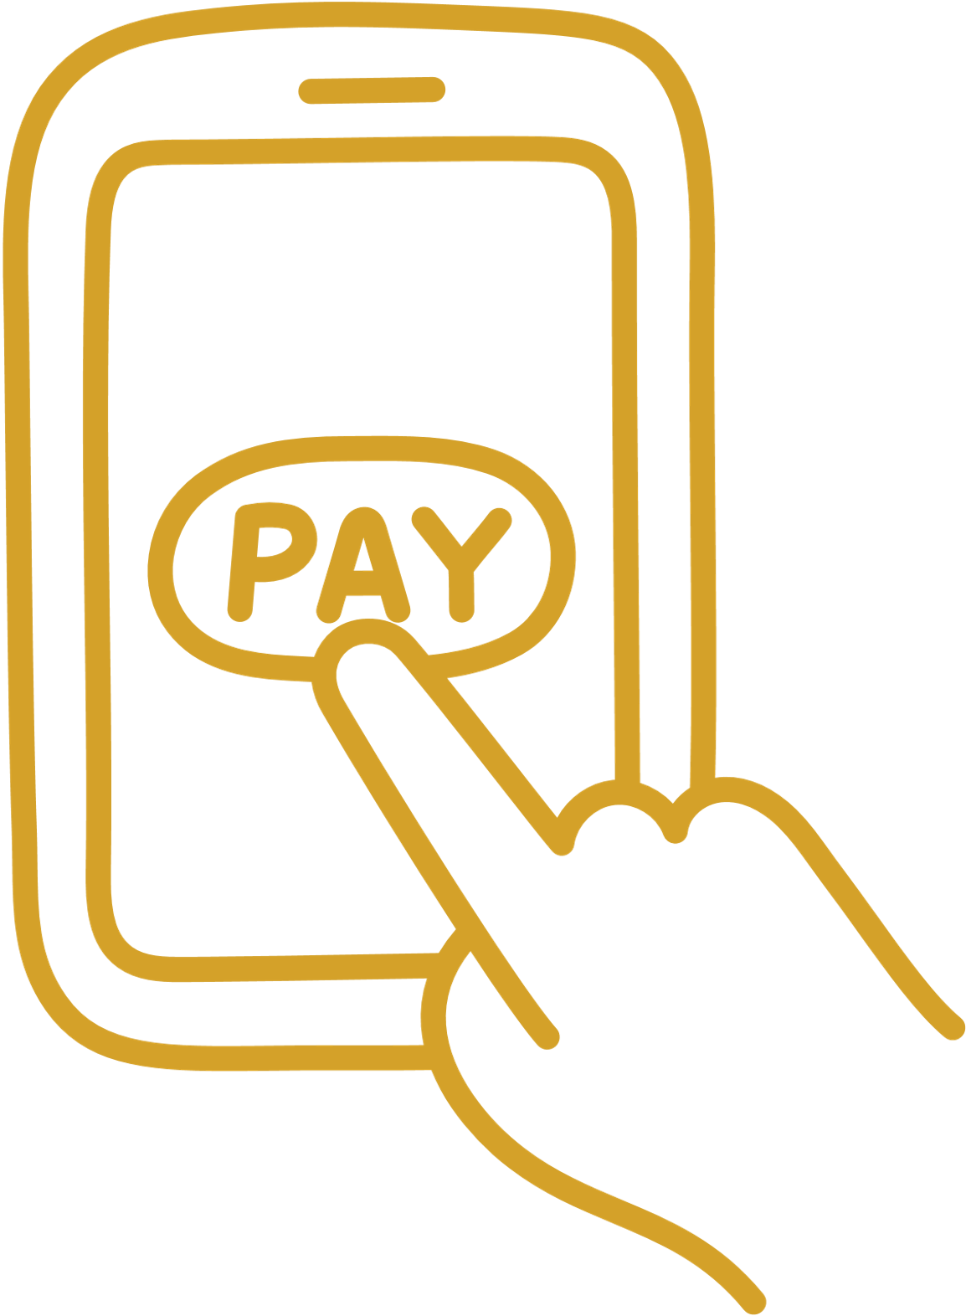

PROCESS FOR REIMBURSEMENT
At the end of each semester:
WCU benefits will approve.
Accounts payable will cut you a check.
Employee emails a payment request , an account statement (bursar bill), a grade report, and the original preapproval form to WCU benefits at benefits@wcupa.edu.​
Employee then pays the semester tuition and tech fee balance owed to the Bursar's Office once the hold has been released. ​

Slide 16
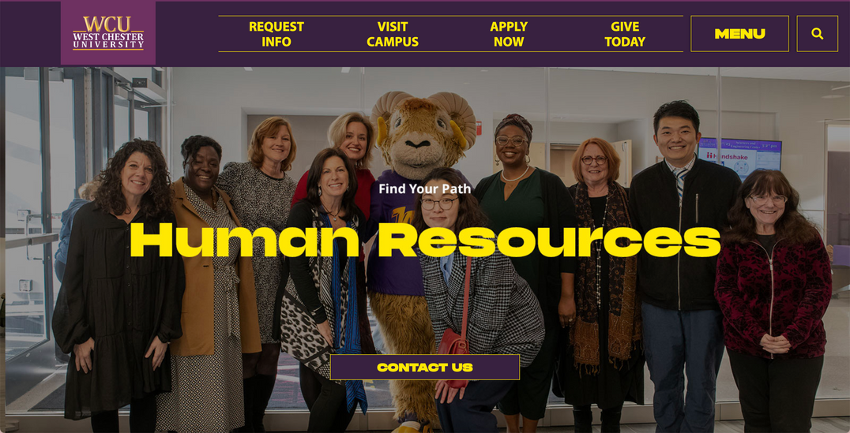

THE HR WEBSITE
Access information:
    Tuition benefits by employee group
    Manager Graduate Degree Reimbursement Program information, resources, and forms
    Explore programs at WCU
    Apply for a waiver
    FAQ’s

Slide 17
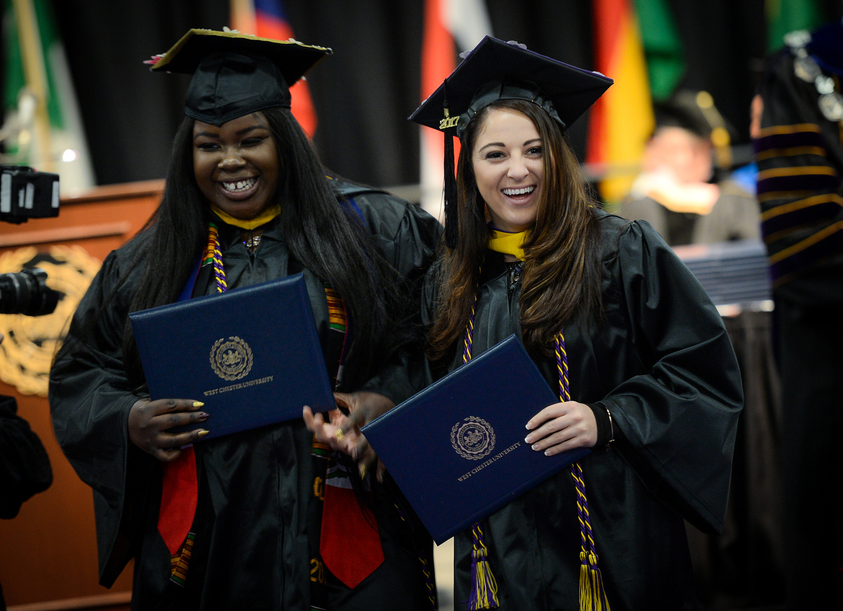
CONTACT INFORMATION AND RESOURCES
HR Benefit Managers
benefits@wcupa.edu
WCU Bursar
erplan@wcupa.edu
Accounts Payable (Reimbursement Inquiries Once approved)
invoices@wcupa.edu
To learn about your benefits and access resources, visit Tuition Waiver & Reimbursement on the HR website.

Slide 18
